Slide 1
NUSec
@Northeastern University
CSAW ESC 2020
Cameron Kennedy
Dennis Giese
Erik Uhlmann
Advised By: Prof. Guevara Noubir
Notes:
Hello everyone,
We are the NUSec CTF team affiliated with Northeastern University,
and in this video presentation we will briefly detail our
experience with the 2020 edition of the CSAW embedded
security competition.

Slide 2
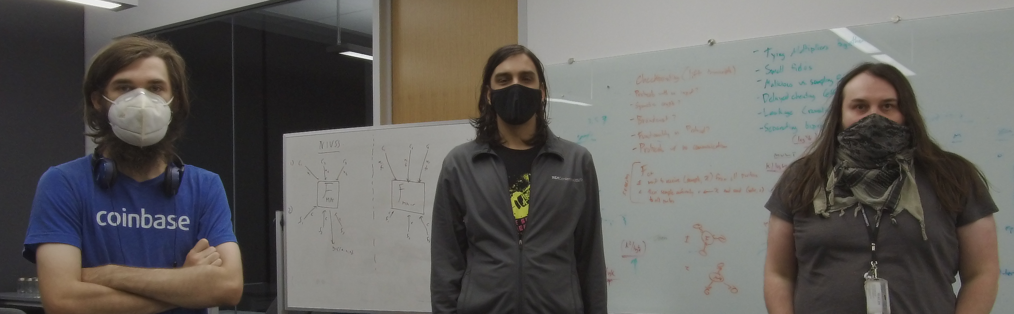

NUSec Team
Dennis Giese
Erik Uhlmann
Cameron Kennedy
Guevara Noubir (Advisor)
Notes:
Our team composed of three principals:
Dennis Giese
Erik Uhlmann
Cameron Kennedy
and was advised by Professor Guevara Noubir.

Slide 3
Challenges
setA:
  Amnesia ✅
  Breakfast ✅
  Burst ✅
  Flood ✅
  Parthenon ✅
setB:
  Chase ✅
  Esrom ✅
  middleman.orig. ✅
  middleman.upd. ✅
  Quiz ✅
  Sequence ✅
setC:
  Game ✅
  Hue ✅
  Recycle ✅
  Virtual1 ✅
  Virtual2 ✅
setD:
  Corrupt ✅
  Impact ✅
  Moonlanding ✅
  Pursuit ✅
Total points: 2200 (excluding original middleman)
Notes:
Over the course of the competition, we managed to solve every single
released challenge, including the original version of Middleman.

Slide 4
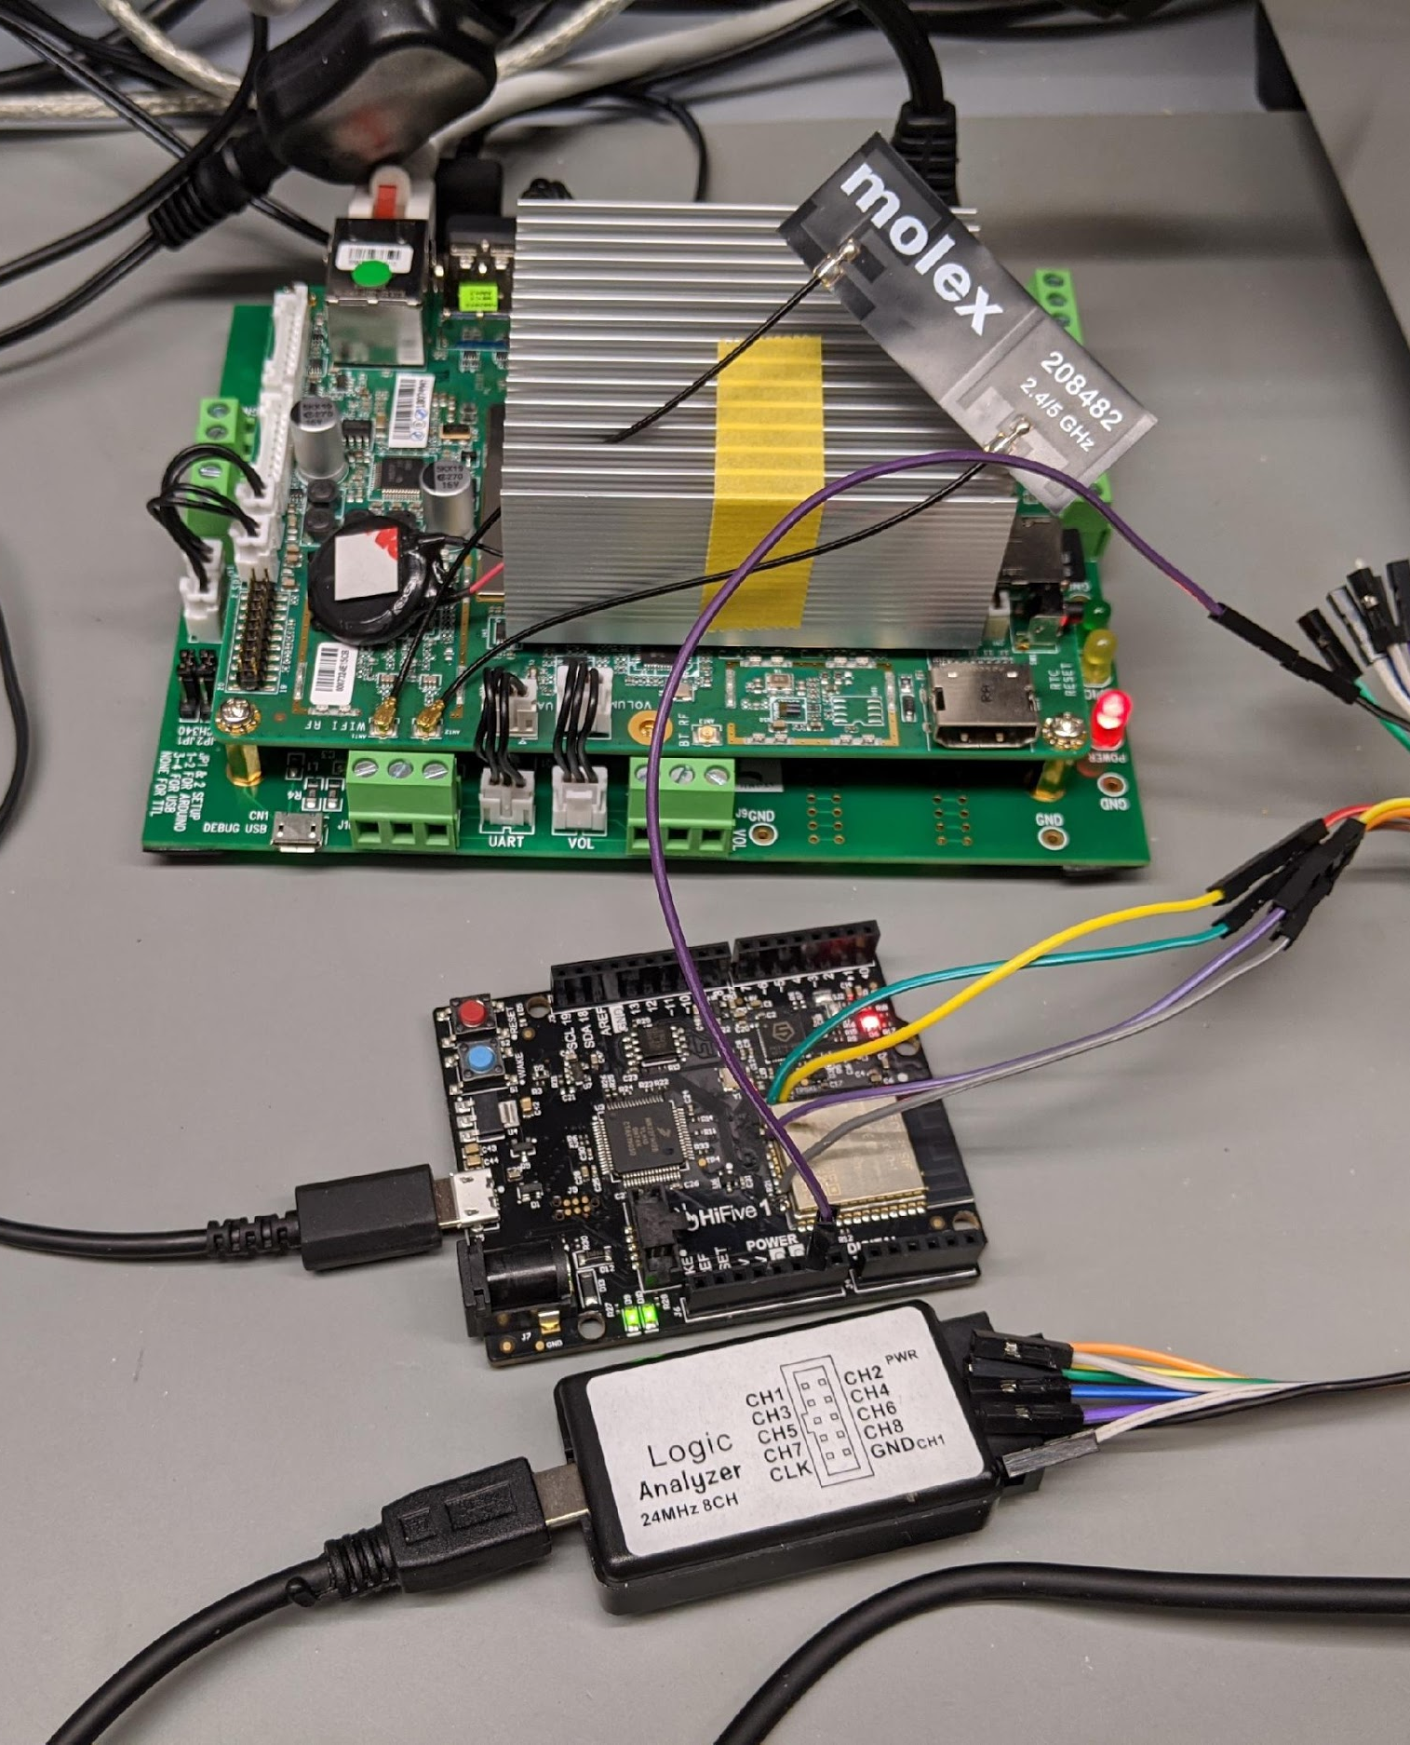
Situation
Challenge:
  Team members cannot meet in Lab
  Coordination difficult
  Limited resources
Solution: Collaboration Platform
  Remote access by team members
  Status of resources and progress visible
  Central storage for data
  Central instance for reverse-engineering
  Limitation: “interactive” actions to the board
Goal: efficient solving of challenges
Notes:
COVID-19 posed some nontrivial logistic issues for our team while
working on the challenges. In particular, the inability for all
members of our team to be present in the lab on a common basis
prevented traditional methods of collaboration. Additionally,
due to us only having a single board to test against, a solution
to the collaboration issue needed to be found. In order to solve
these dilemmas, we developed a system which would allow our team
members to remotely connect to a device capable of controlling
the HiFive board and connecting to the WiFi network broadcast by it.
In addition to this capability, we soldered connectors from a logic
analyzer to the pins corresponding to the SPI bus on the ESP32 chip
so as to be able to inspect traffic traveling over it.

Slide 5
Remote Setup of Hardware
Base: Atomic Pi
  Hi-Five Board connected over USB
  Logic Analyzer tapped into SPI bus
  Tools for automatic upload of firmware and debugging
HiFive1 Rev B
Atomic Pi
RISCV FE310-G002
J-Link
Debug
USB
HW tools
JTAG
UART
Logic Analyzer
Challenge binaries
Tapped connection (CLK, MISO, MOSI)
USB
SPI
Scripts
ESP32-Solo
SSH
Ethernet
Notes:
In order to ease development, we implemented some custom tooling
for interacting with the board which provided our team the ability
to see if another individual was utilizing certain capabilities.
In this demo, we demonstrate the process of connecting to our board's
host machine and uploading the chase challenge. We then demonstrate
connecting to the board's UART interface via minicom, and then
connecting to the challenge server over WiFi.

Slide 6
Tools
Ghidra
GDB
Sigrok
Z3
QEMU
pwntools
Custom Linker
Automated Solver Scripts
Utility Scripts
Notes:
Finally, we would like to summarize which tools we utilized for
conducting the ESC. These can be placed into two broad categories:
off-the-shelf and custom. In the first category, we utilized
Ghidra for static analysis and collaborate reverse engineering
GDB for dynamic analysis and debugging
Sigrok for parsing traces of the SPI bus
Z3 for solving problems in the space of SAT (e.g., burst).
QEMU for emulating a RISC-V CPU and running software locally
Pwntools to aid in the development of custom scripts
With respect to custom tools we developed over the course of the competition,
we utilized:
The custom linker script (esclinker.py) which would allow us to
load the challenge binaries and then jump into our own code
Automated Solver scripts to provide us the ability to reproduce
challenge solutions
Utility scripts for easing the process of interacting with the
HiFive board.

Slide 7
Offline Emulation — esclinker.py
Emulated functions of challenge binaries on Linux using QEMU
  Custom loader code in C to load firmware data at correct address, then call custom_main
  Disabled additional hardware access by runtime patching
0000 0000 - 1FFF FFFF
ROM, HW peripherals
0000 0000 - 1FFF FFFF
(Unmapped / loader code)
2000 0000 - 3FFF FFFF
QSPI flash
2000 0000 - 3FFF FFFF
Firmware (rwx)
4000 0000 - 7FFF FFFF
(Reserved)
4000 0000 - 7FFF FFFF
(Unmapped)
8000 0000 - 8000 3FFF
RAM
8000 0000 - 8000 3FFF
Zeroed (rwx)
void patch_out(void* _func) {
uint8_t* func = _func;
func[0] = 0x82; // 2 byte ret: 82 80
func[1] = 0x80;
}
int custom_main(int argc, char* argv[]) {
// patch functions
void* vTaskDelay = (void*) 0x20016280;
patch_out(vTaskDelay);
void* release_puts = (void*) 0x2001796e;
patch_out(release_puts);
// ....
}
Challenge HW memory map
Emulated memory map
Notes:
In order to assist solving many of the challenges, we developed the capability to dynamically call functions within the original challenge binaries using a custom linker script. This allowed us to perform offline emulation of functions in the original binaries using a desktop Linux computer and QEMU. The script invokes C compilation of custom user code, located in the custom_main function, along with the original challenge binary and startup code that initializes the memory map to be similar to the environment on the real challenge hardware, as shown in the diagram on the left. Since the emulated environment didn’t have any of the hardware peripherals present on the actual platform, we additionally patched out any challenge binary functions that used hardware registers at runtime. The offline emulation capability allowed us to run custom brute force and dynamic instrumentation procedures without the need to debug using the real challenge hardware, or lift any challenge binary code to an emulatable form manually, which greatly increased our solving efficiency. In fact, we barely instrumented or debugged using GDB and OpenOCD on the real hardware despite also having that capability as local emulation using our system turned out to be faster and easier.

Slide 8

Collaborative reverse engineering
NSA’s Ghidra supports collaboration
  integrated collaboration server
  multiple users can work on the same challenge
Challenge: RISCV support in development
  ghidra_riscv plugin provided ability to
  analyze binaries
Notes:
Due to the aforementioned logistic challenges posed by COVID-19,
we required a solution which would allow team members to collaborate
while reverse engineering the challenges. In order to solve this
problem, we utilized a ghidra collaboration server so as to allow our
team members to check-in contributions to our reverse engineering
efforts.

Slide 9
Automated solving
Board was unreliable in successfully standing up its WiFi
Often required to run our solutions multiple times (e.g., chase)
Automated solve scripts enabled us to reproduce results easily despite unreliable challenges
  Additionally helpful for time-sensitive challenges (e.g., amnesia, game)
  Offline emulation capabilities allowed efficient solution computation using original challenge binaries
Notes:
In order to make our challenge solutions easily reproducible, we
automated the solving process for every challenge by utilizing
python, pwntools, and miscellaneous other custom programs. In this
example, we demonstrate one such program solving the recycle challenge
by repeatedly querying the challenge server to gain enough ciphertext
samples to leverage the repeated XOR cipher which proved to be the core
of this challenge.
Additionally, the offline emulation capabilities allowed us to quickly compute answers
for challenges using the original challenge binary, without the need to run debugging routines
on the actual challenge hardware or lift the challenge function code by hand. This was especially useful
for the impact challenge, where our solver script invoked a solution brute force procedure
and returned the answer produced automatically.

Slide 10

Other approaches
Angr
  Use-case for symbolic execution
  Issue: compressed instructions are not supported
  All challenges were solvable without symbolic execution

Slide 11
More Information in our final report: https://nusec.us/csaw2020

